Slide 1
PGE 392K HW 1 Fall 2020
Grading Rubric
Slide Number | 2 | 3 | 4 | 5 | 6 | 7 | 8 | 9 | 10 | 11 | 12 | Total
Point | 10 | 10 | 10 | 10 | 10 | 10 | 10 | 10 | 5 | 5 | 10 | 100
SHADAB, Mohammad Afzal

Slide 2
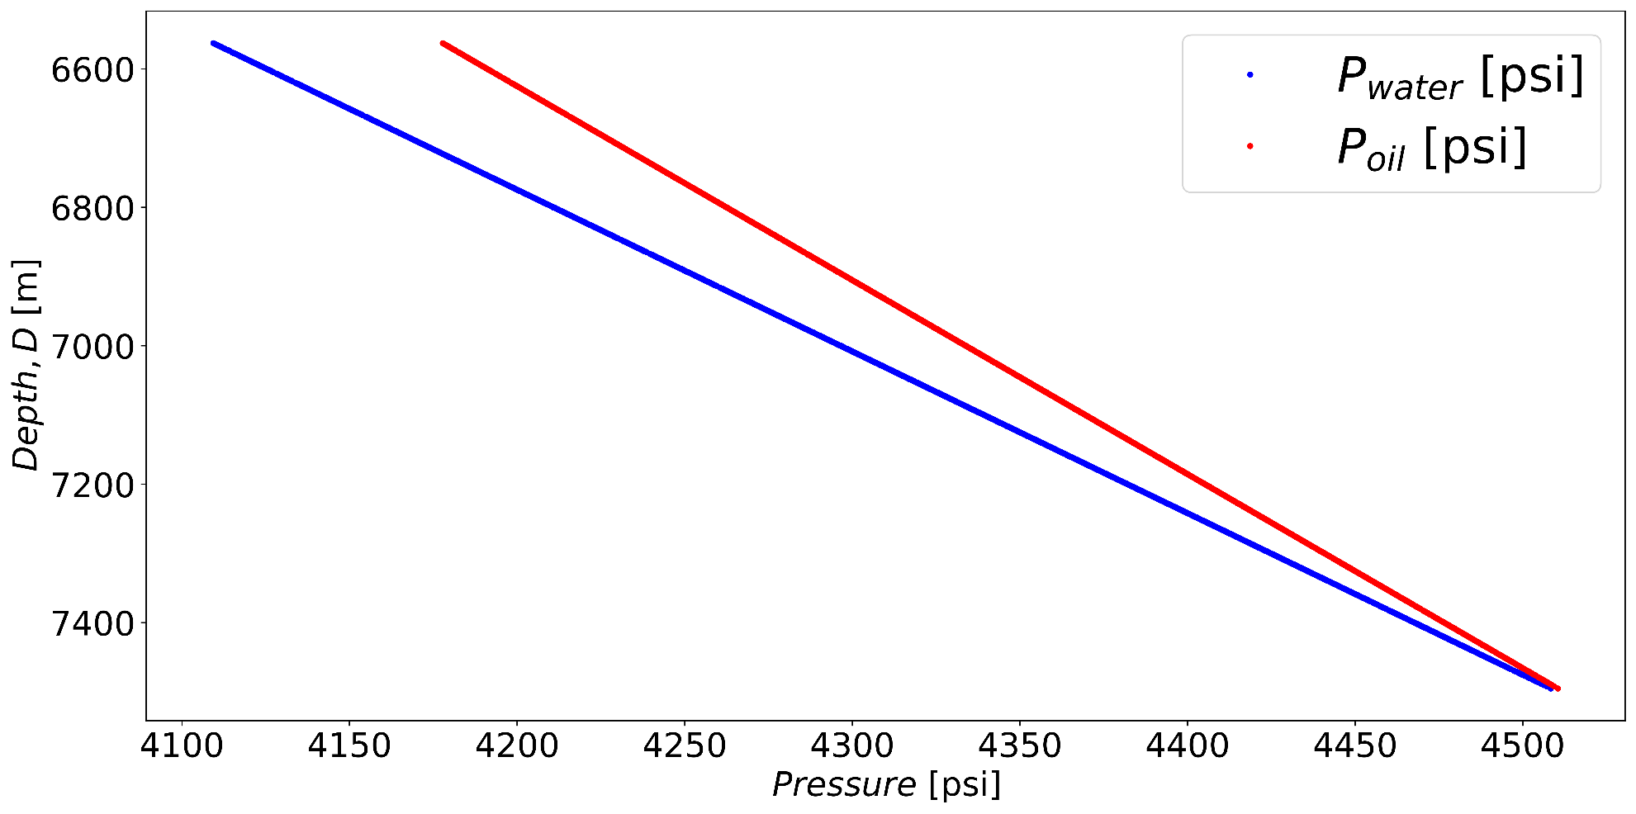
Problem 1.1. Pressure (x-axis) versus depth (reversed y-axis) for both oil and water

Slide 3
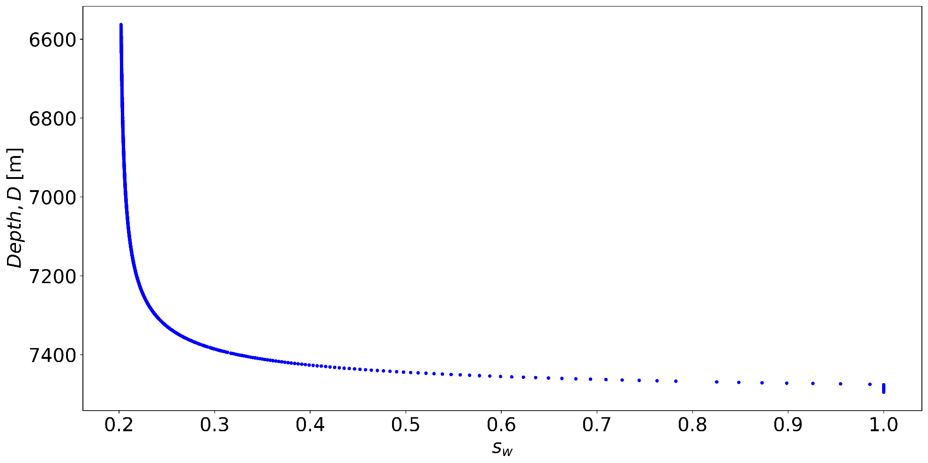
Problem 1.2. Water saturation (x-axis) versus depth (reversed y-axis)

Slide 4
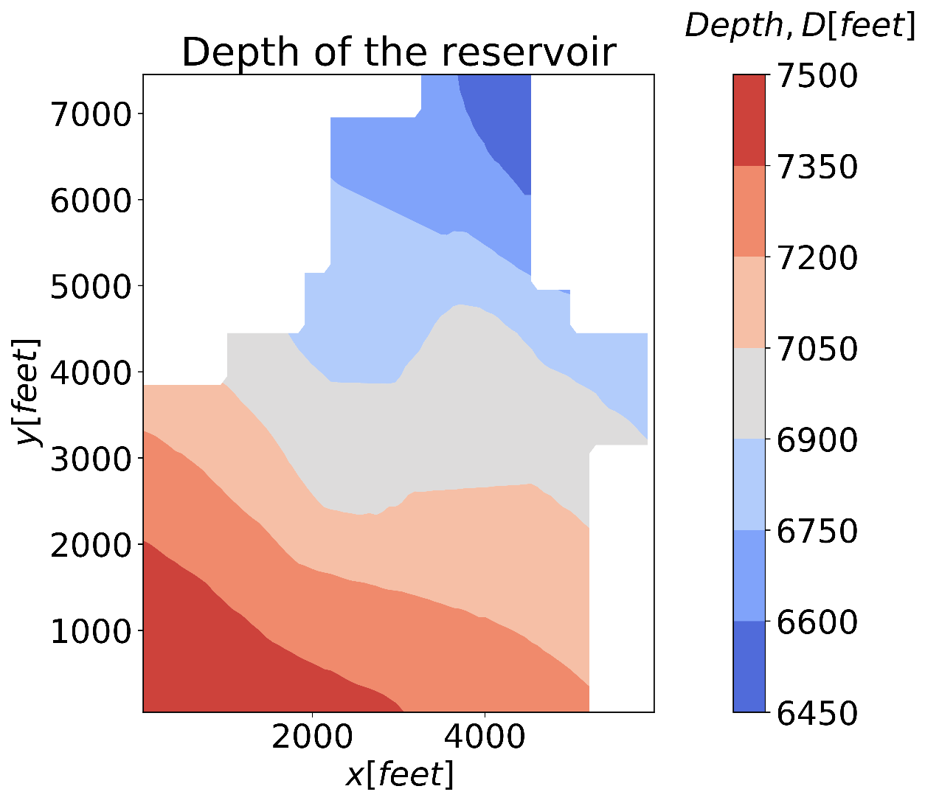
Problem 1.3. Depth on an X-Y cartesian grid (with a colorbar)

Slide 5
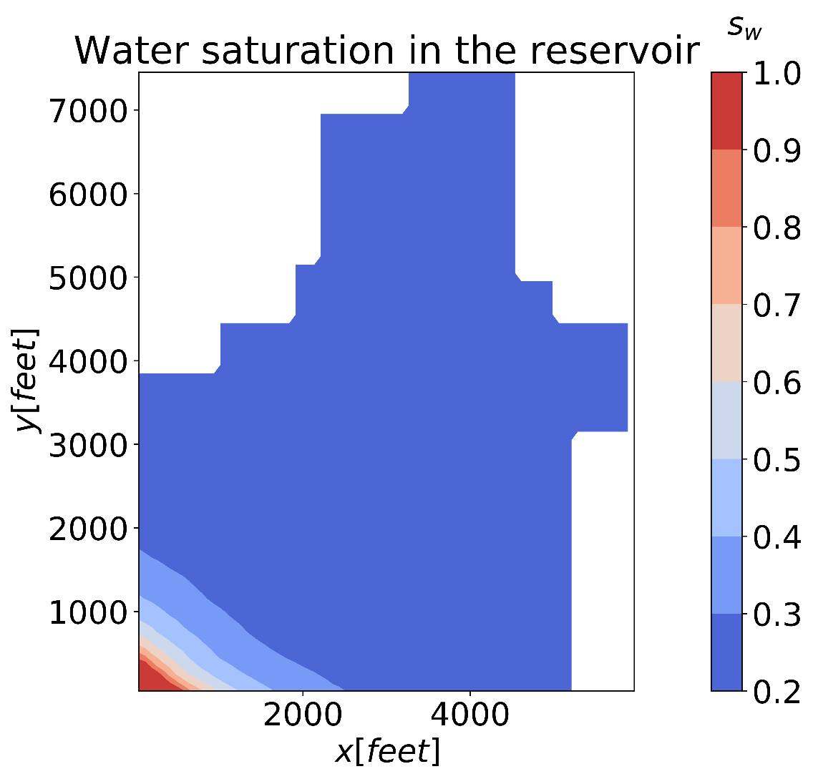
Problem 1.4. Water saturation on an X-Y cartesian grid (with a colorbar)

Slide 6
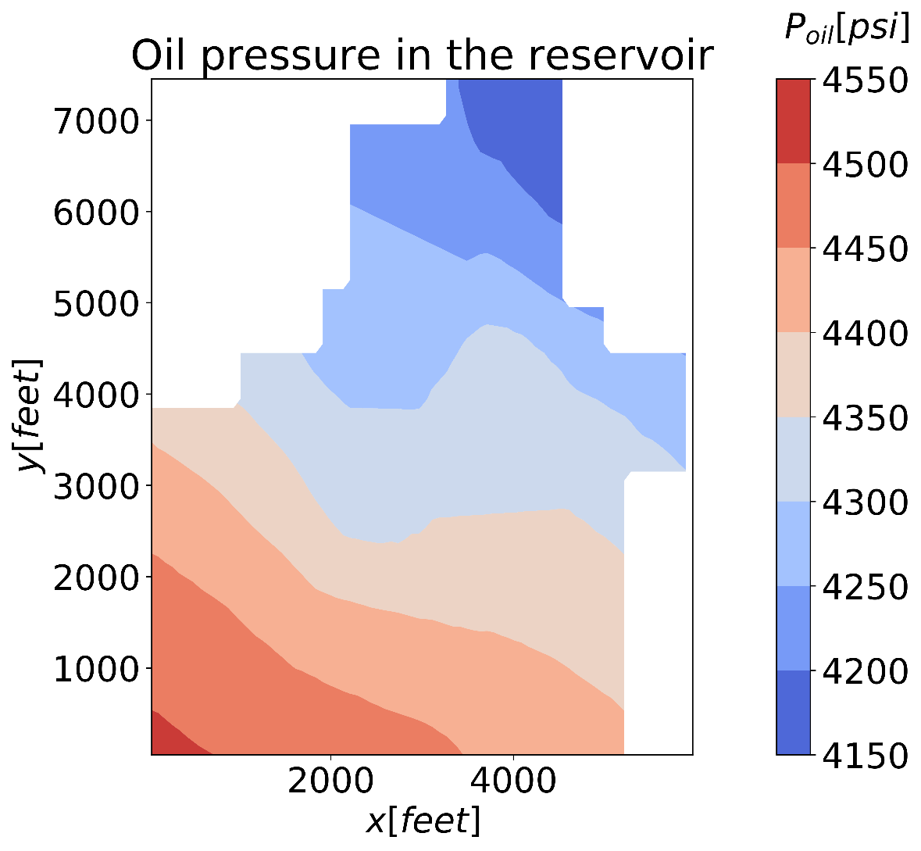
Problem 1.5. Oil pressure on an X-Y cartesian grid (with a colorbar)

Slide 7
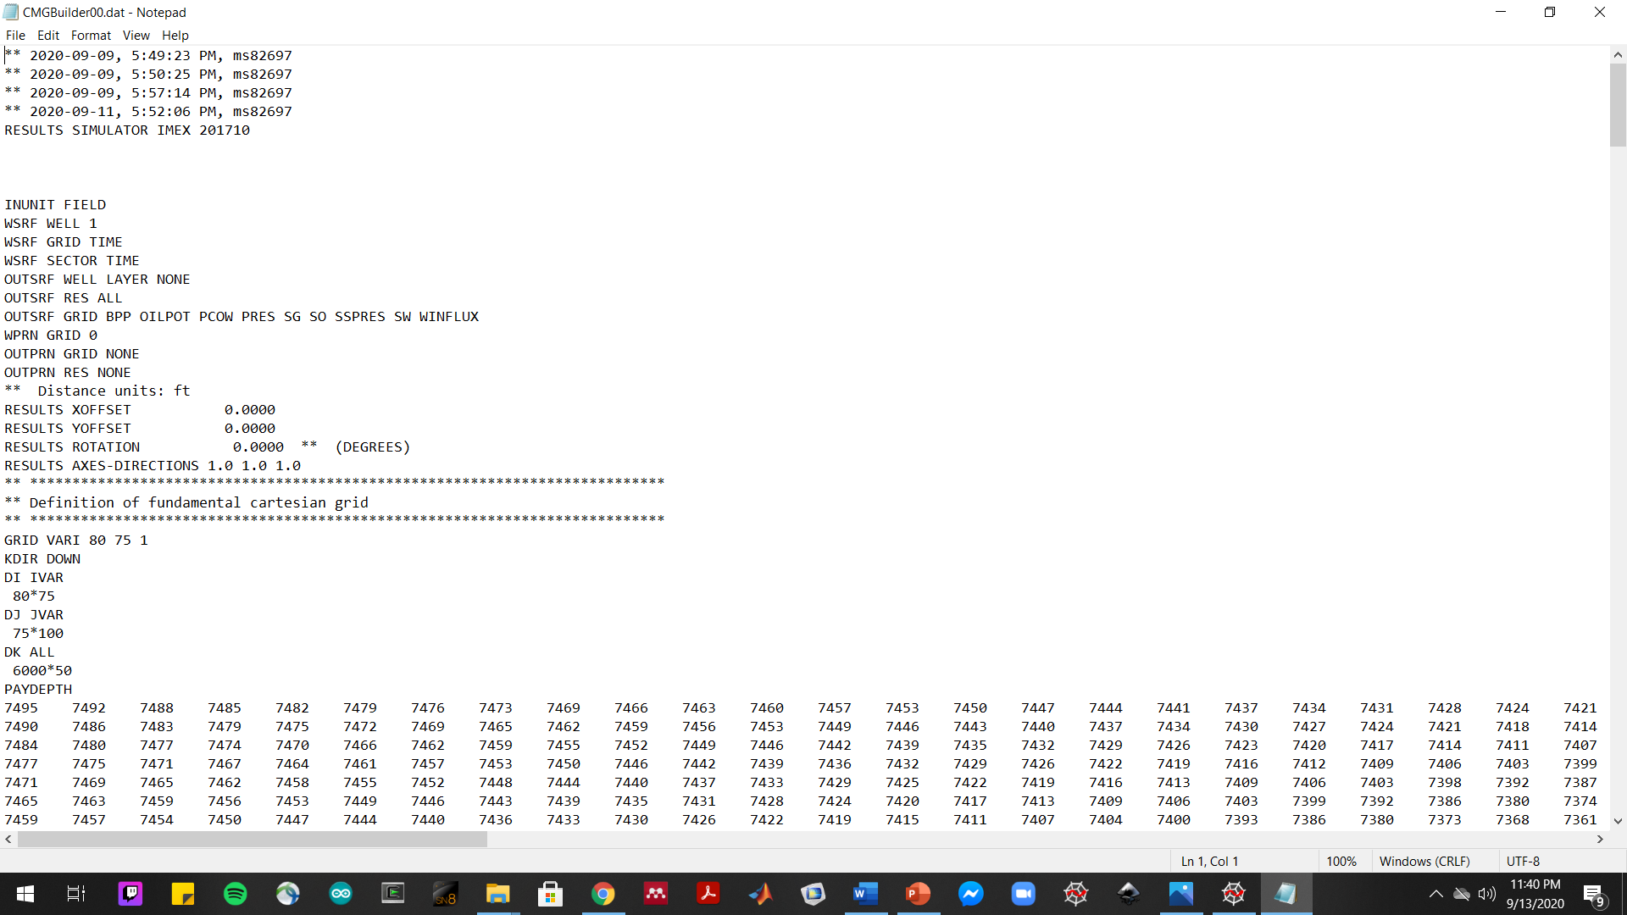
Problem 2 Screenshot(s) of .dat file

Slide 8
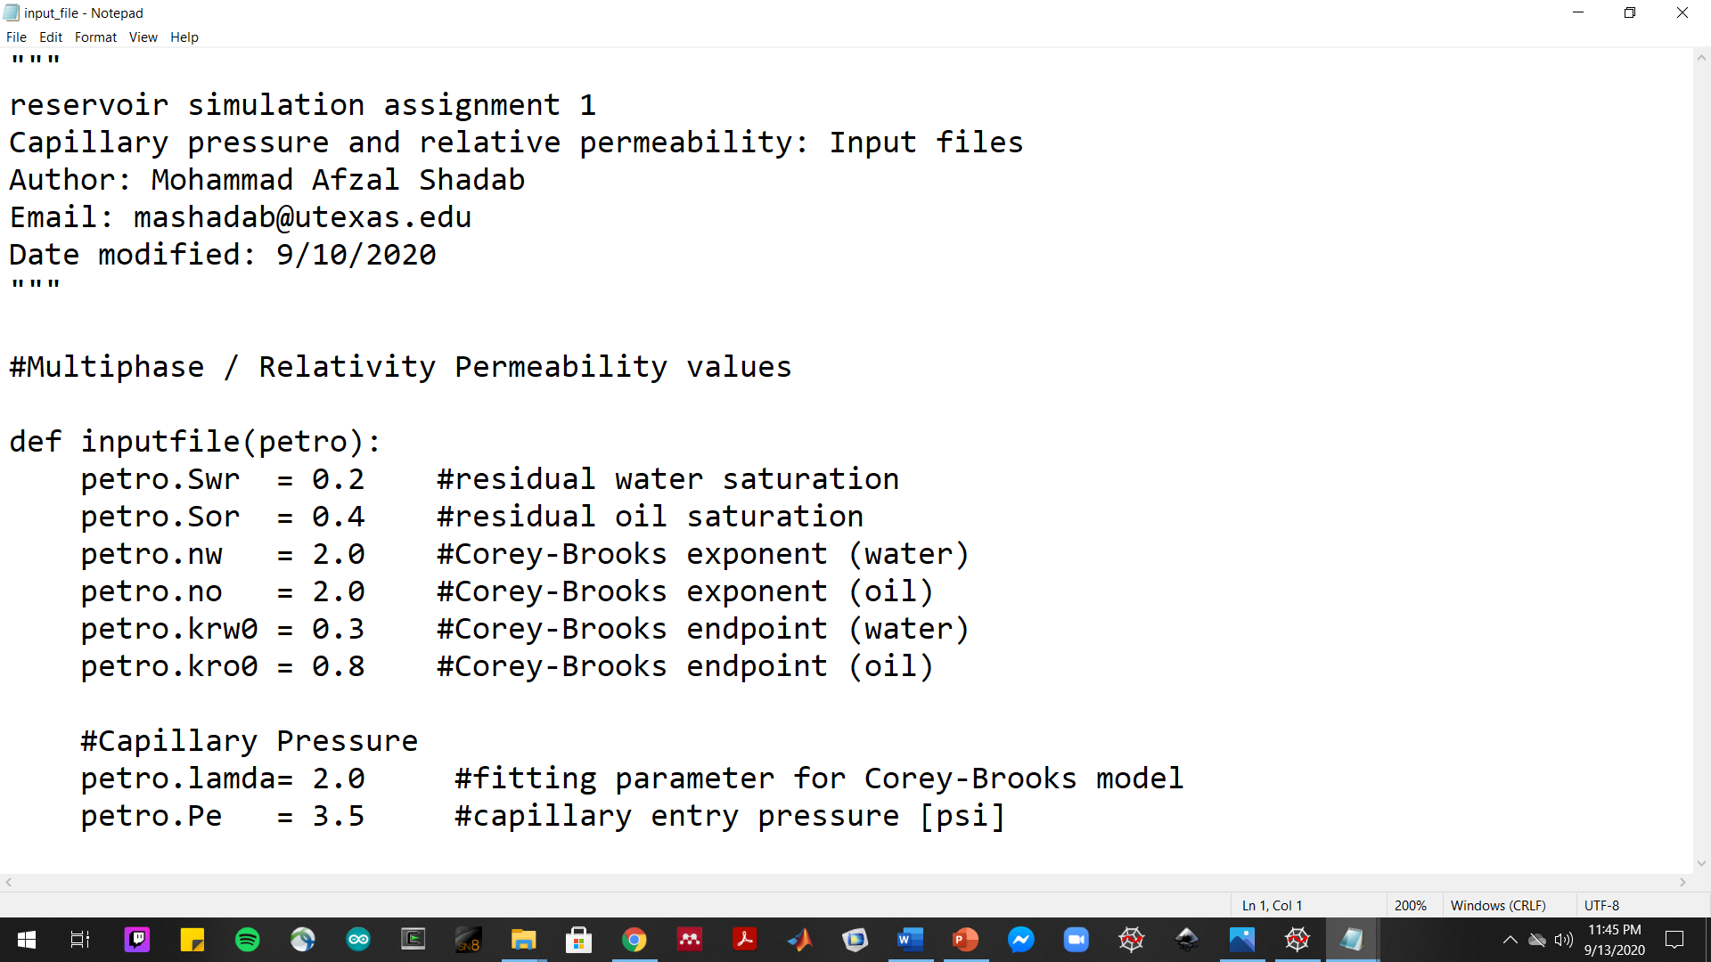
Problem 3.1 Screenshot(s) of input file

Slide 9
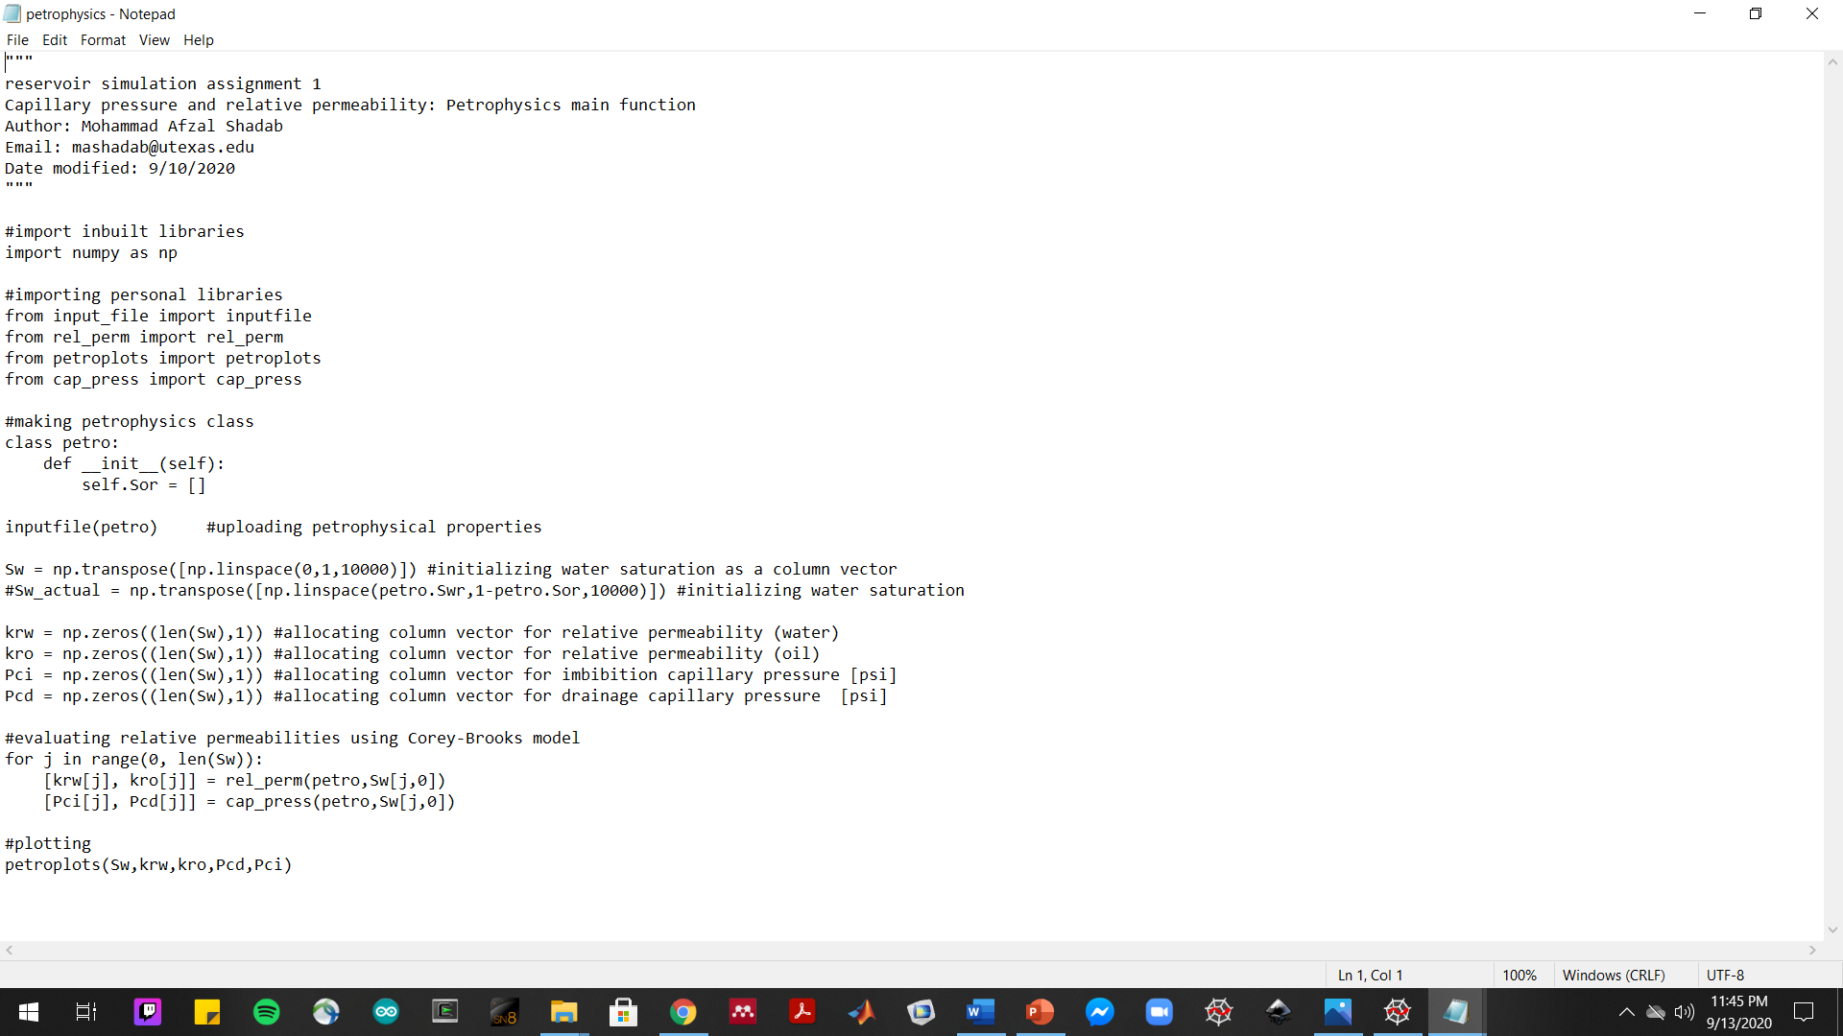
Problem 3.2 Screenshot(s) of main script

Slide 10
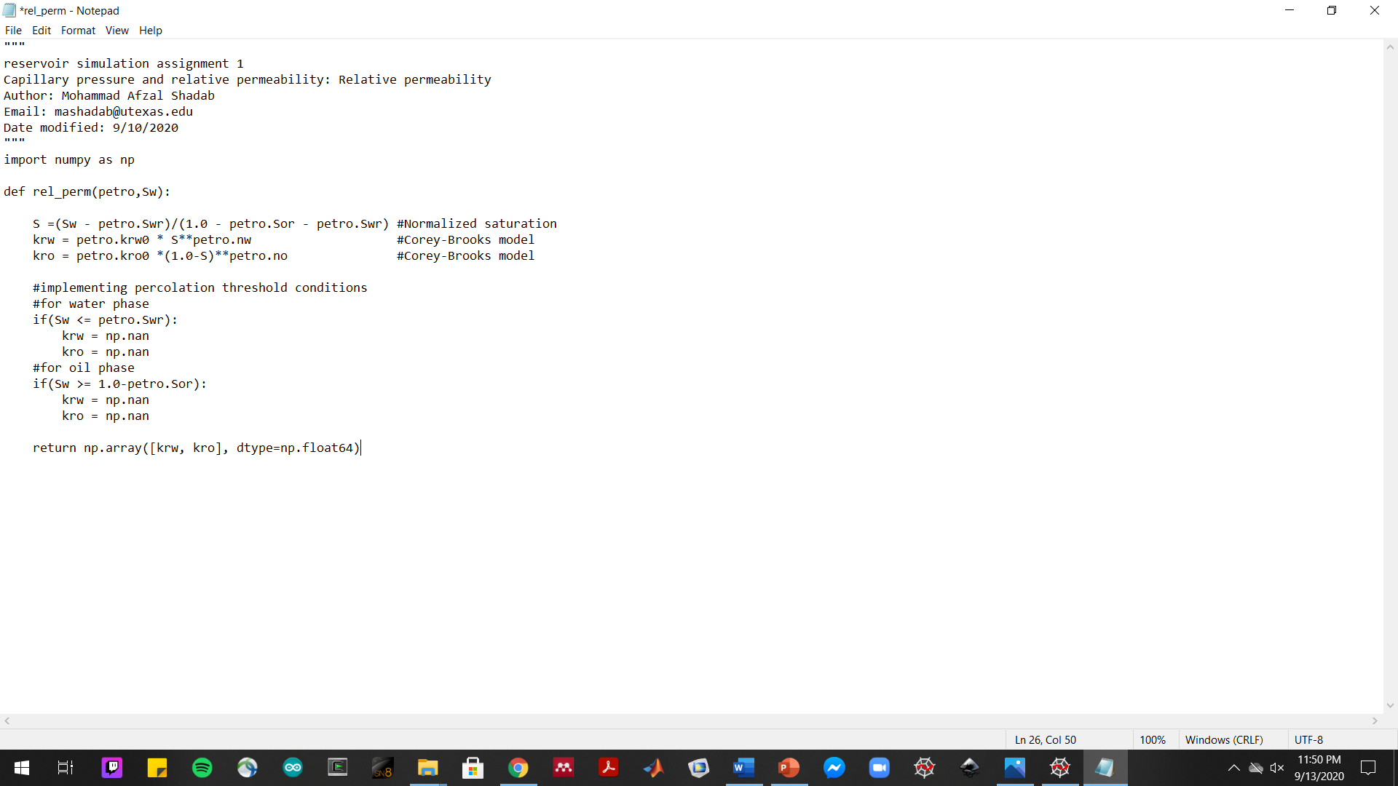
Problem 3.3 Screenshot(s) of relative permeability function

Slide 11
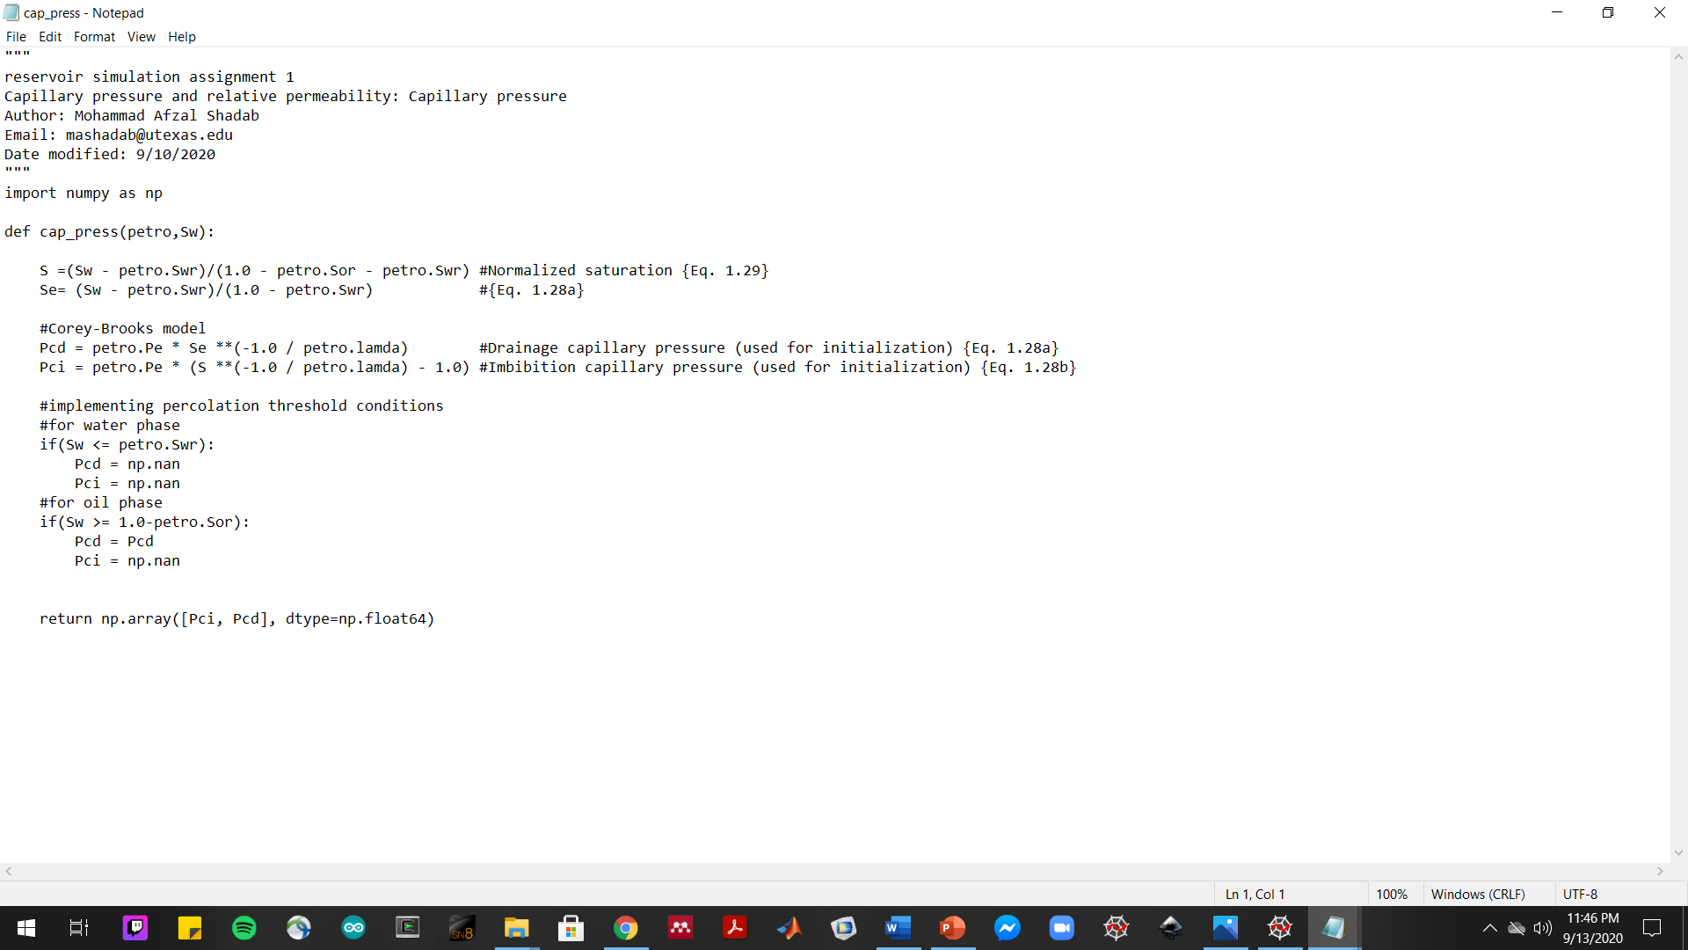
Problem 3.4 Screenshot(s) of capillary pressure function

Slide 12
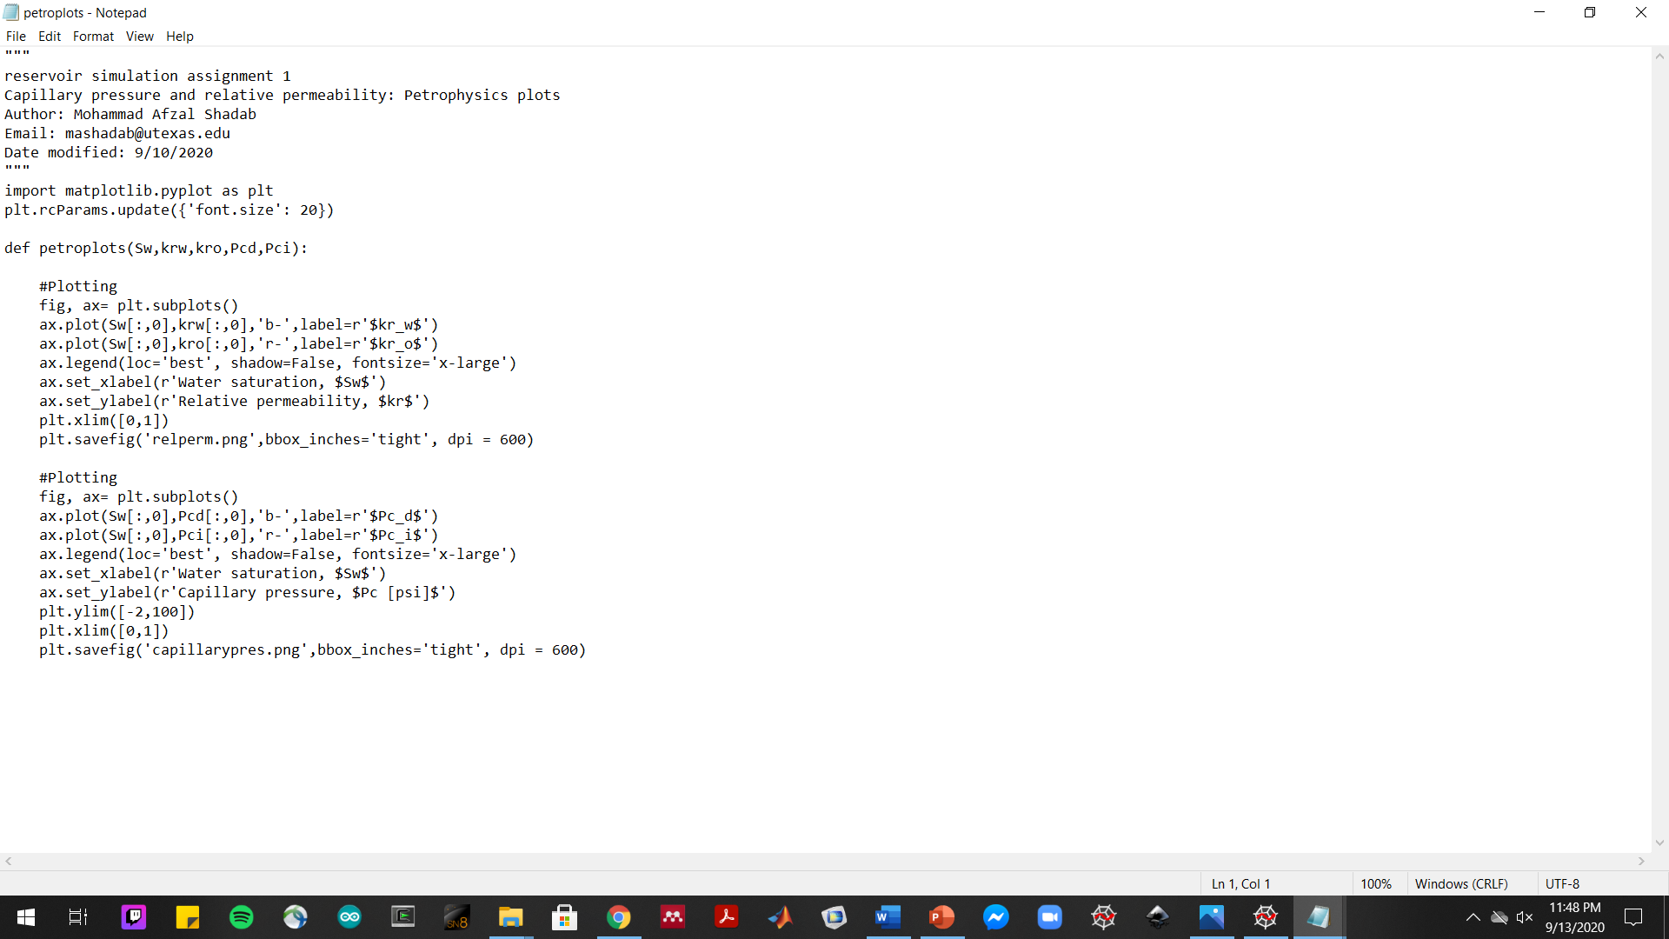
Problem 3.5 Screenshot(s) of plotting function

